Slide 1
The Bayes-Sics
A Workshop on Bayesian Stats + Methods for Astrophysics Hugh McDougall UQ Astro Group Meeting, Mon 27/4

Slide 2

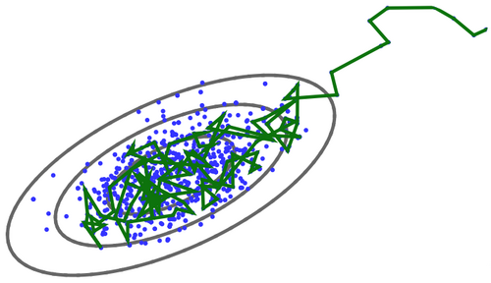
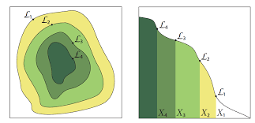
In This Presentation
Maths
Conditional Probability
Bayesianism vs Frequentism
How to Speak Bayesian
Methods
MCMC
Nested Sampling
Fancy Stuff
MCMC
Nested Sampling
Iain Murray, 2016 Via Wikipedia
Josh Speagle, 2016

Slide 3
Part 1 – Bayesian Maths

Slide 4




Conditional Probability: An Example
You are at an academic conference with 20 representatives from 19 Texan Universities & 1 French University
One of the attendees tells you they “live in Paris”
What is the probability they are from France?

Slide 5
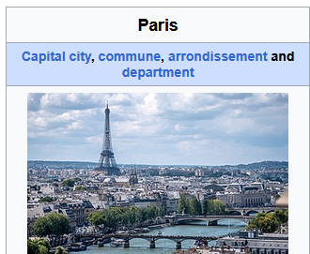
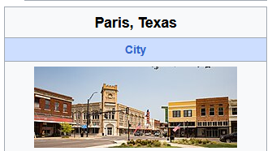
Conditional Probability: An Example
Paris, France
Paris, Texas
But…
3.06% of French
0.08% of Texans
We need to use conditional probability

Slide 6
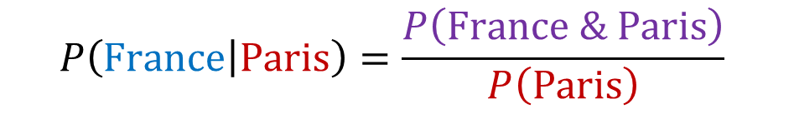
Conditional Probability: An Example
From France
From Paris
From France & From Paris
$$P\left(France | Paris\right)=\frac{P\left(France \& Paris\right)}{P\left(Paris\right)}$$
Getting data (From Paris) conditions our probabilities: it restricts which universes we might be living in

Slide 7
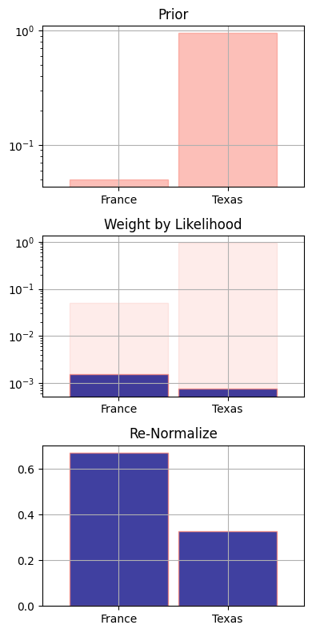
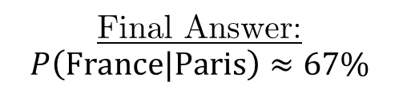
Conditional Probability: An Example
Prior Probability
Renormalize
Re-weight by Likelihood of producing observation
Posterior Probability
Final Answer: $P\left(France|Paris\right)≈67\%$

Slide 8


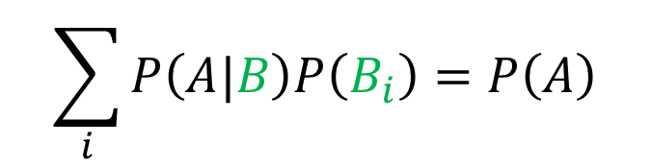
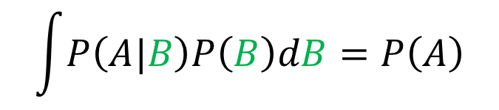
Conditional Probability: Axioms
Moving things across the vert (from variable to condition):
$$P\left(A,B\right)=P\left(A|B\right)P\left(B\right)$$
This can be chained together:
$$P\left(A,B,C\right)=P\left(A,B|C\right)P\left(C\right)=P\left(A|B,C\right)P\left(B|C\right)P\left(C\right)$$
Integrating out a variable:
$$\int{P\left(A|B\right)P\left(B\right)dB}=P\left(A\right)$$
$$\sum_{i}{P\left(A|B\right)P\left(B_{i}\right)}=P\left(A\right)$$
$$Continuous$$
$$Discrete$$

Slide 9
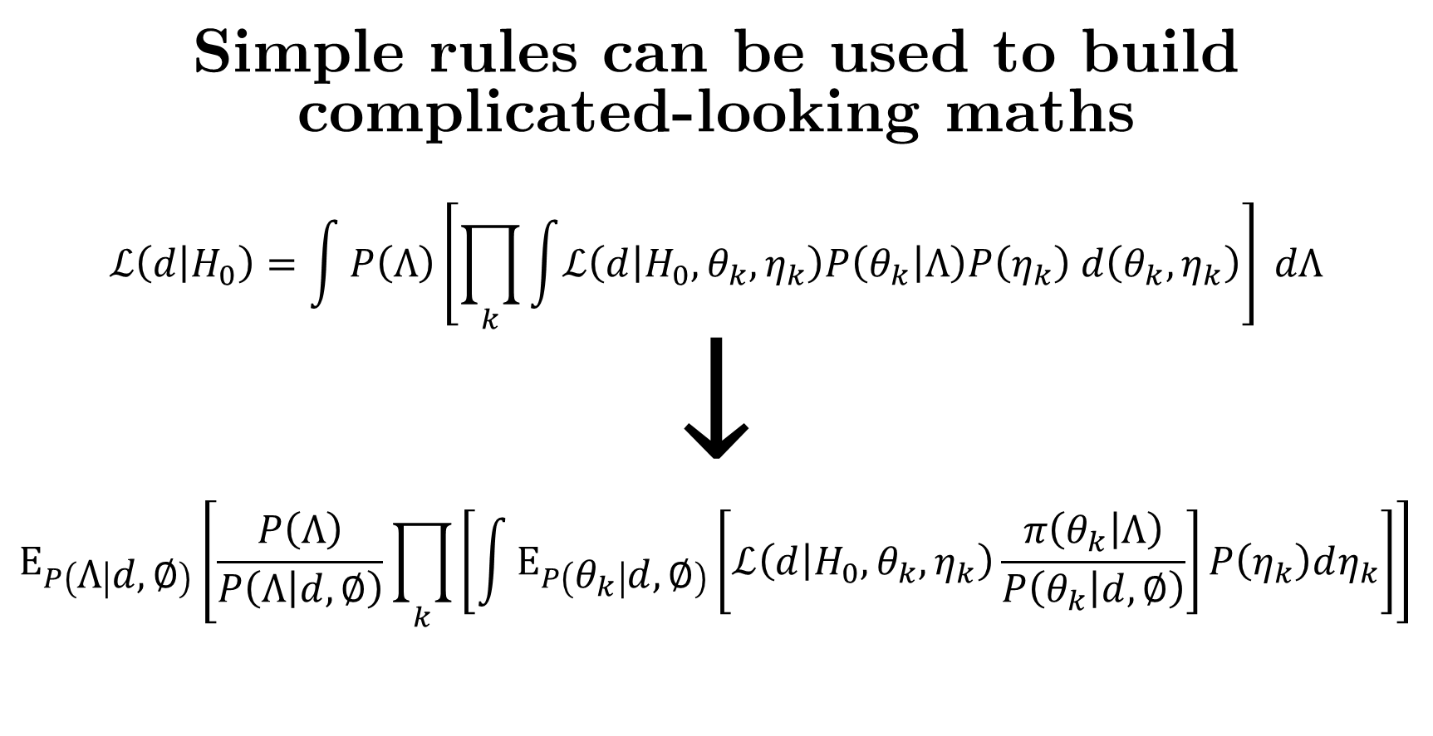
Simple rules can be used to build complicated-looking maths
$$ℒ\left(d | H_{0}\right)=\int{P\left(Λ\right)\left[\prod_{k}{\int{ℒ\left(d | H_{0},θ_{k},η_{k}\right)P\left(θ_{k} | Λ\right)P\left(η_{k}\right) d\left(θ_{k},η_{k}\right)}}\right]} dΛ$$
$$↓$$
$$E_{P\left(Λ | d,∅\right)}\left[\frac{P\left(Λ\right)}{P\left(Λ | d,∅\right)}\prod_{k}{\left[\int{E_{P\left(θ_{k} | d,∅\right)}\left[ℒ\left(d | H_{0},θ_{k},η_{k}\right)\frac{π\left(θ_{k} | Λ\right)}{P\left(θ_{k} | d,∅\right)}\right]P\left(η_{k}\right)dη_{k}}\right]}\right]$$

Slide 10
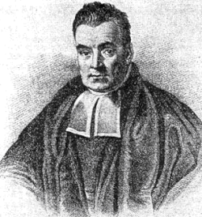
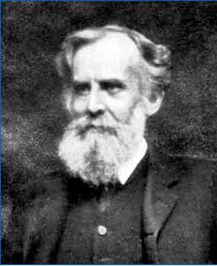
Bayesianism vs Frequentism
Bayesianism
Invented by Reverend Thomas Bayes
Frequentism
Invented by John Frequentism
Via Wikipedia
Via Wikipedia
Asks the Question: “Given what I just saw, how much should I re-weight my different explanations about which universe I’m in?”
How to Spot:
Priors, MCMC, conditional probabilities, well understood physics
Asks the Question: “In the least interesting universe, how hard would it be to get something as strange as what I just saw by random coincidence?”
How to Spot:
P-values, test statistics, poorly understood systems

Slide 11

Practical Example: Parameter Constraint
You flip a coin 24 times and it lands heads 15 of those times.
What can we say about the fairness (H/T weighting) of this coin?
Via istockphoto.com

Slide 12
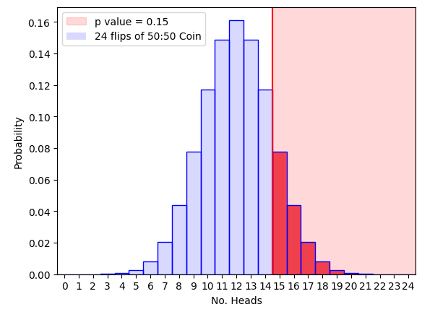
Frequentist Approach
We need:
A definition of “Strangeness”
A way to predict strangeness in a boring universe (a null hypothesis)
In the least interesting universe, how hard would it be to get something as strange as what I just saw by random coincidence?

Slide 13
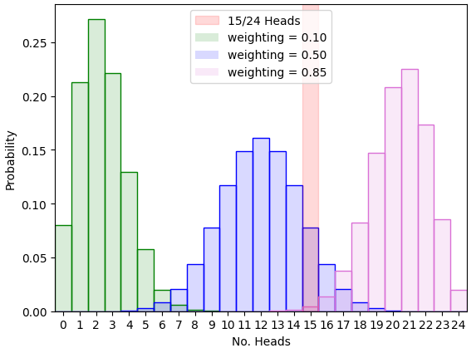
How to find a Better Explanation?
Frequentism tries to tell us if the coin is 50:50
What if we want to measure the weighting? What heads/tails probability is the most likely? What uncertainty is there on that?
This is a parameter constraint problem

Slide 14
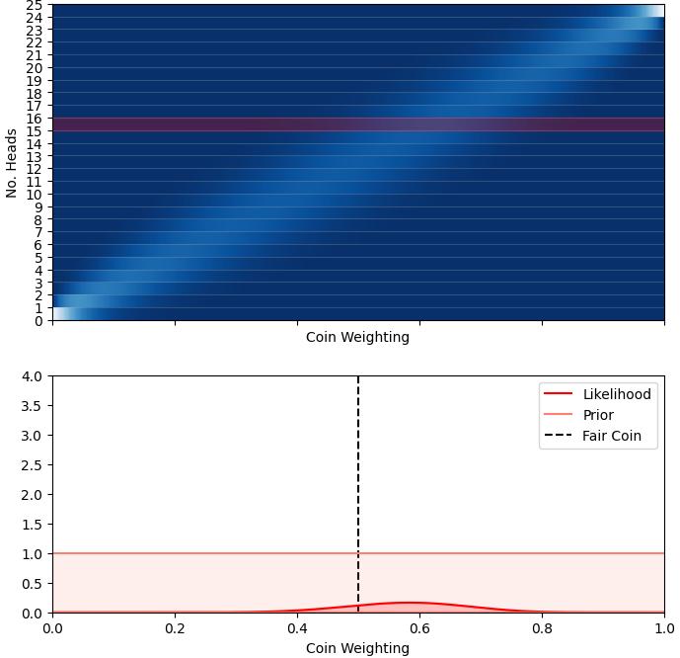
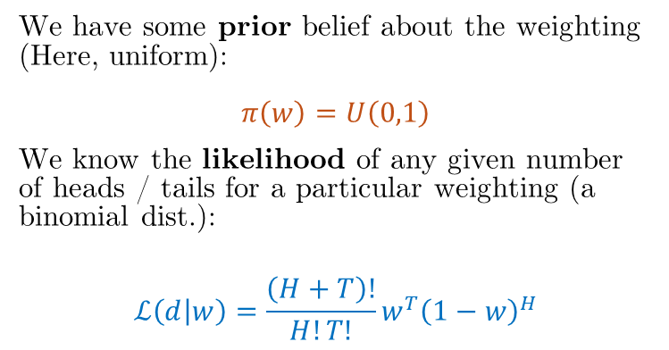
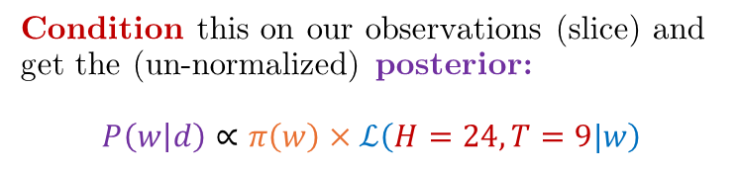

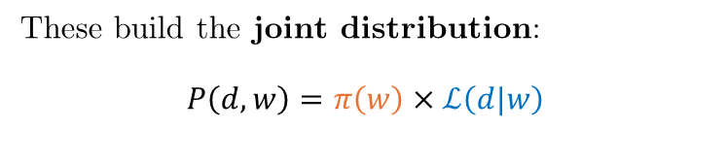

Joint Distribution: $P\left(w,d\right)$
Conditioned / Posterior: $P\left(w|d\right)$
We have some prior belief about the weighting (Here, uniform): $$π\left(w\right)=U\left(0,1\right)$$
We know the likelihood of any given number of heads / tails for a particular weighting (a binomial dist.):
$$ℒ\left(d | w\right)=\frac{\left(H+T\right)!}{H!T!}w^{T}{\left(1−w\right)}^{H}$$
These build the joint distribution: $$P\left(d,w\right)=π\left(w\right)×ℒ\left(d|w\right)$$
Condition this on our observations (slice) and get the (un-normalized) posterior: $$P\left(w | d\right)∝π\left(w\right)×ℒ\left(H=24,T=9|w\right)$$

Slide 15


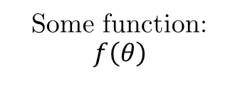


The Forward Model
Not easily invertible
$$π\left(θ\right)$$
$$ℒ\left(d | θ\right)$$
Parameters go in
Some function: $$f\left(θ\right)$$
Physics / Predictions happen Here
$$θ$$
$$d$$
Priors / Parameters
Generative Model / Likelihood
Observations / data
Going forward (easy, often analytical) lets us use parameters to make predictions for data
Going backwards (hard, usually numerical) lets us use data to make measurements for parameters

Slide 16
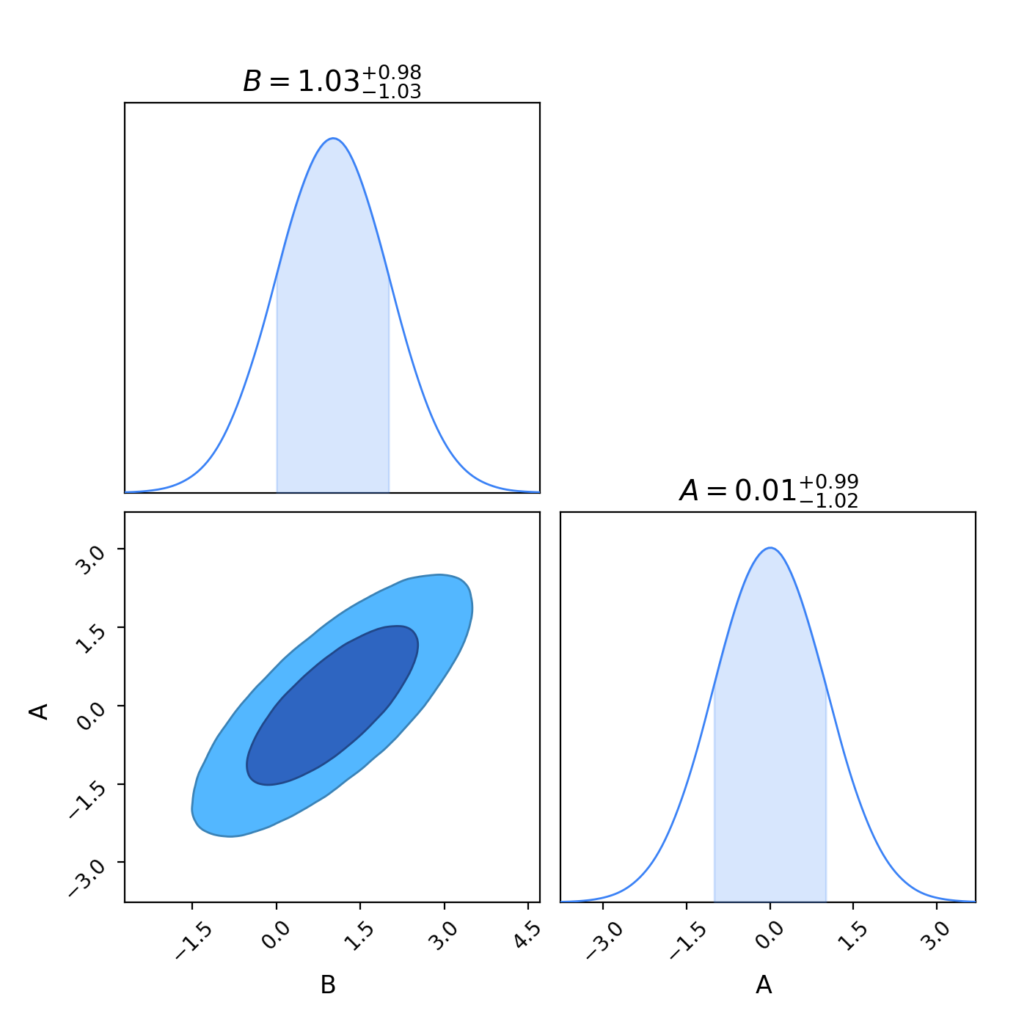
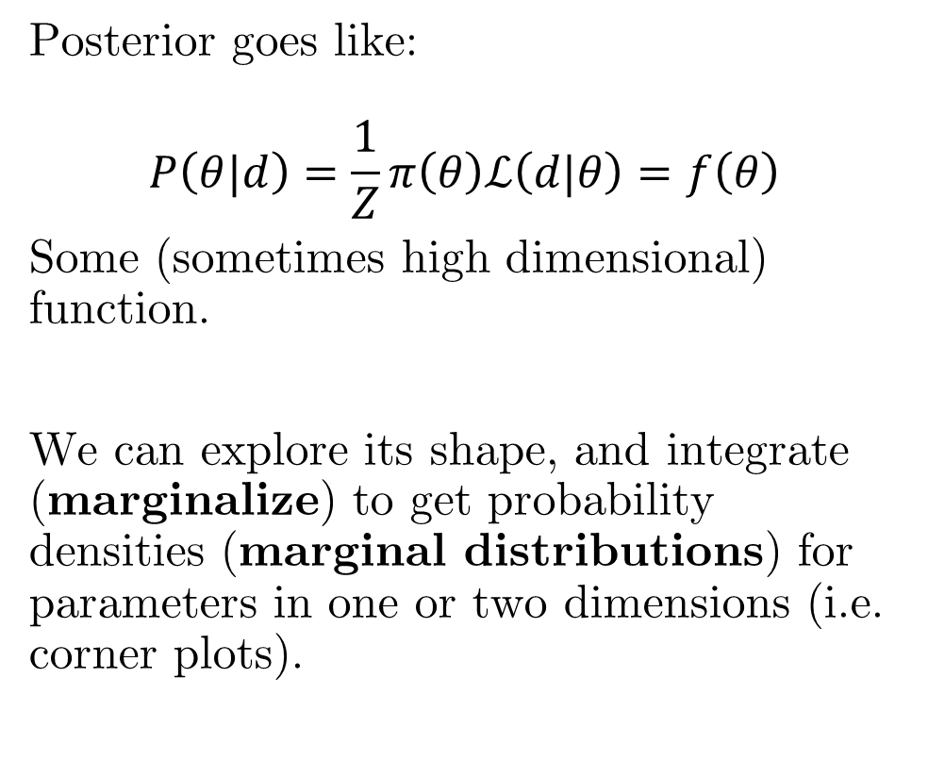
Parameter Constraint In Higher Dimensions
Posterior goes like:
$$P\left(θ|d\right)=\frac{1}{Z}π\left(θ\right)ℒ\left(d|θ\right)=f\left(θ\right)$$
Some (sometimes high dimensional) function.
We can explore its shape, and integrate (marginalize) to get probability densities (marginal distributions) for parameters in one or two dimensions (i.e. corner plots).

Slide 17
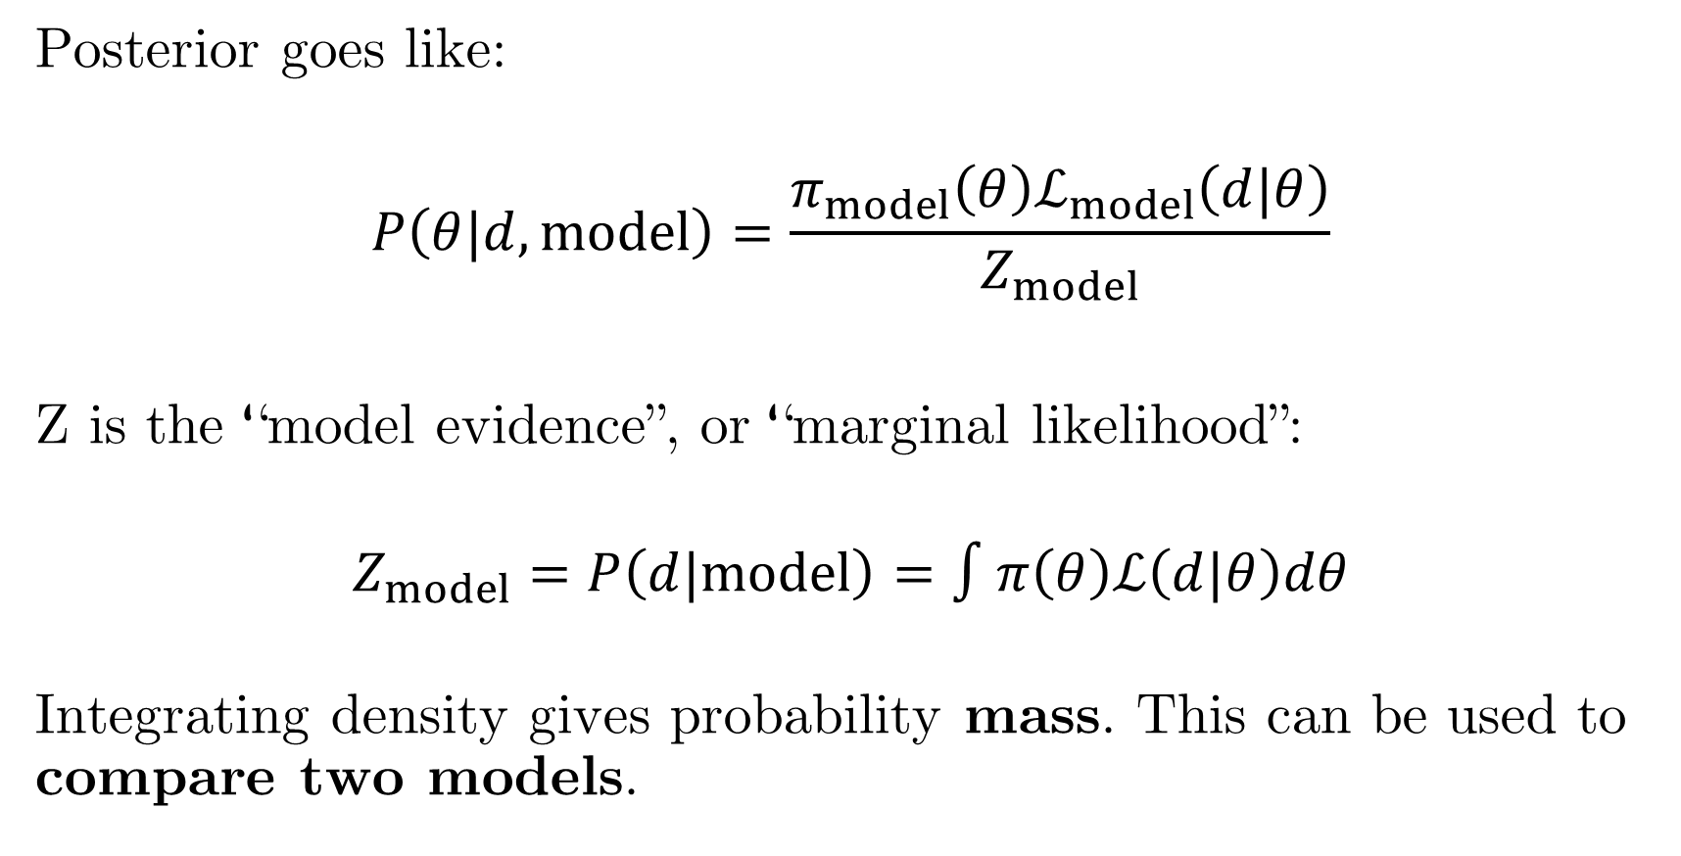
What about that integration Constant?
Posterior goes like:
$$P\left(θ|d,model\right)=\frac{π_{model}\left(θ\right)ℒ_{model}\left(d|θ\right)}{Z_{model}}$$
Z is the “model evidence”, or “marginal likelihood”:
$$Z_{model}=P\left(d|model\right)=∫π\left(θ\right)ℒ\left(d|θ\right)dθ$$
Integrating density gives probability mass. This can be used to compare two models.

Slide 18
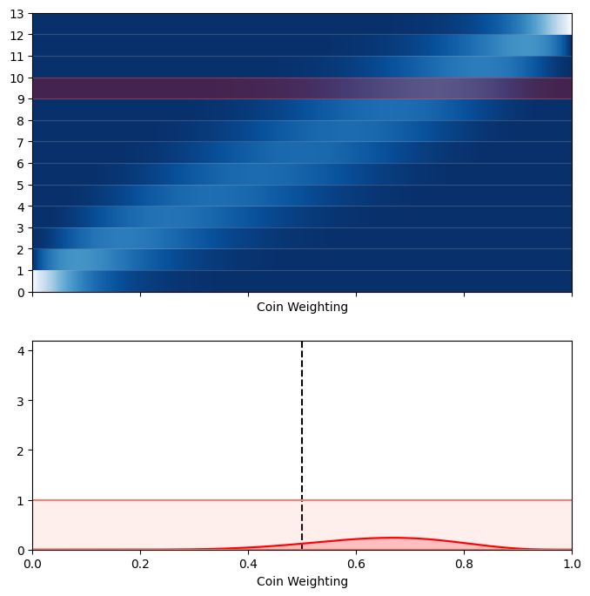
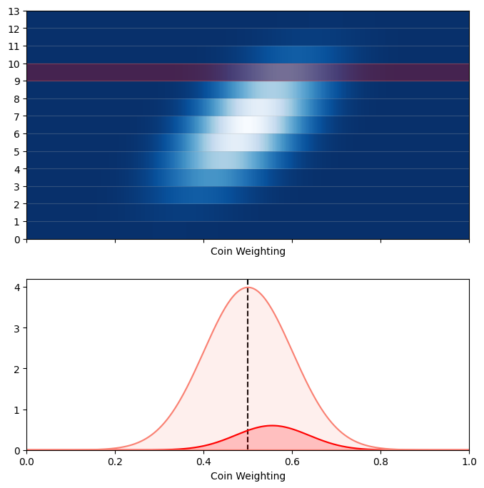
Practical Example: Model Comparison
Two explanations: The coin came from a mint where $π\left(w\right)=𝒩\left(μ=50\%, σ=10\%\right)$ or it’s a loaded coin ($π\left(w\right)=U\left(0,1\right)$). Which of these is more likely?
Different priors, same process
Different evidences / normalizing masses
Ratio is the Bayes factor

Slide 19
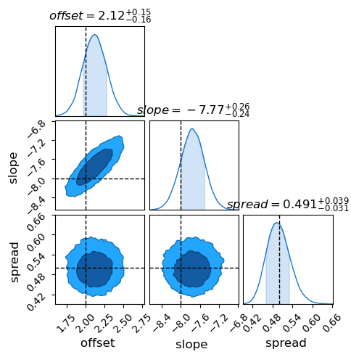
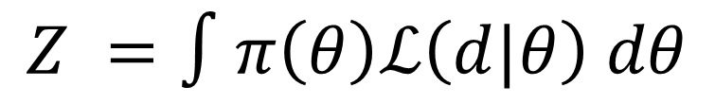
Things we Want to Do
Parameter Constraint
Model Comparison
$$Z =∫π\left(θ\right)ℒ\left(d|θ\right) dθ$$
Get the shape of the posterior
Get the normalization of the posterior

Slide 20
Part 2 – Bayesian Methods

Slide 21
The Bayesian Methods Family Tree
Information
Criteria
Markov Chain
Monte Carlo (MCMC)
Nested
Sampling
Fancy Stuff
AIC
BIC
DIC
Hamiltonian
Monte Carlo (HMC)
Dynamic Nested
Sampling
Stochastic Variational Inference
Simulated Bayesian Inference
Parameter Constrain | Model Comparison
Parameter Constrain | Model Comparison
Parameter Constrain | Model Comparison

Slide 22
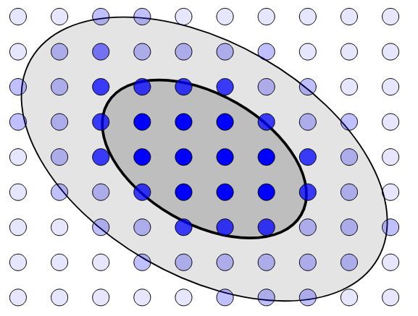
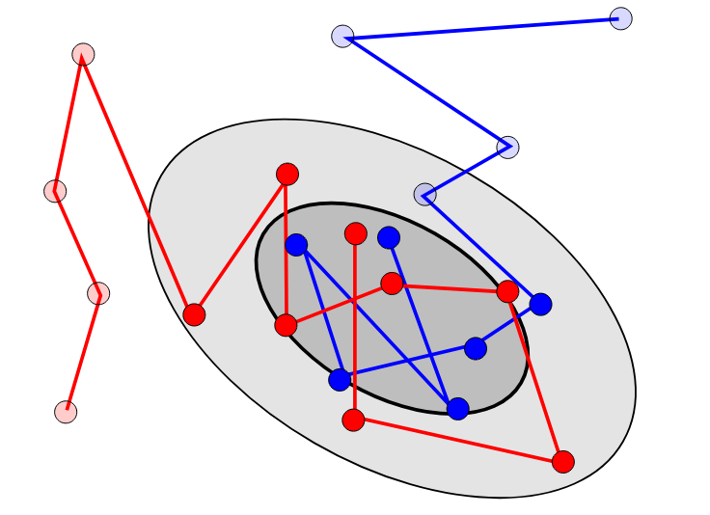
Markov Chain Monte Carlo (MCMC)
Grid Integration: Too Expensive
MCMC: Only Evaluate Near Best Fit

Slide 23
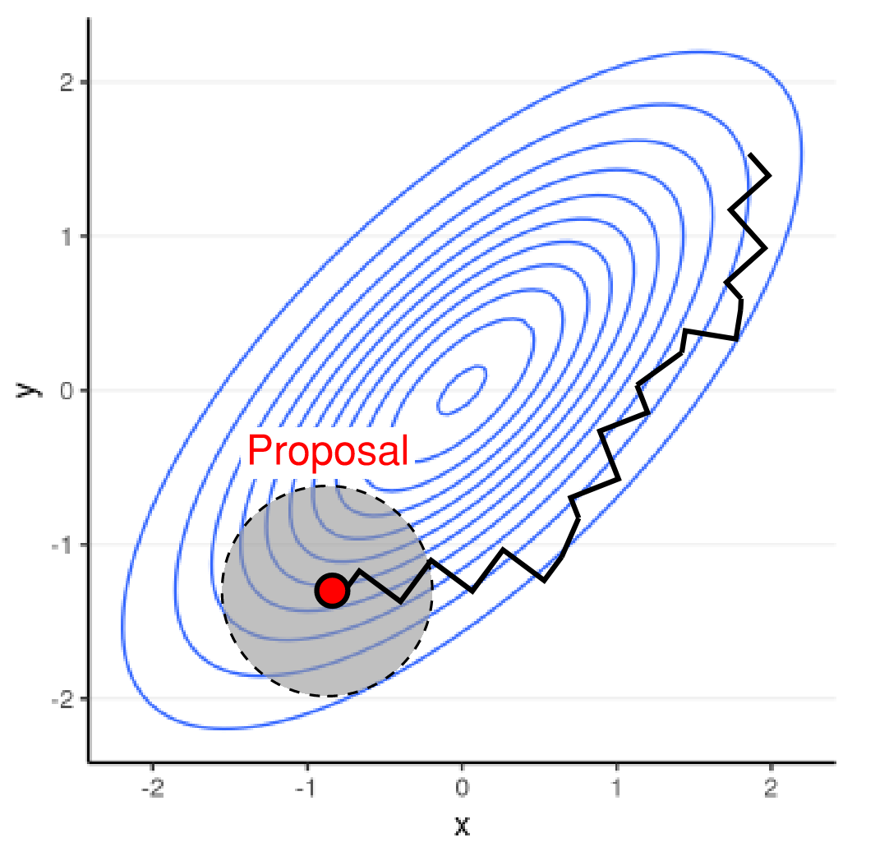
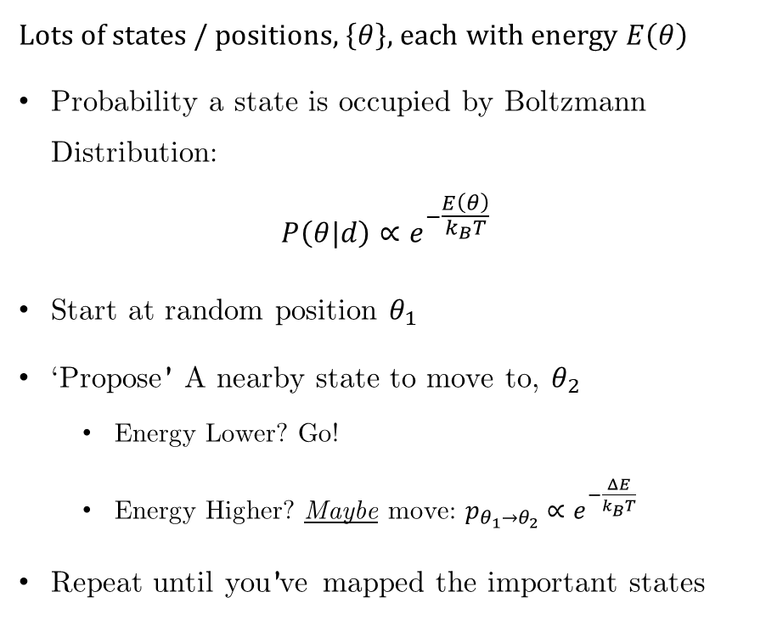
The Metropolis Algorithm: Statistical Mechanics!
Lots of states / positions, $\left\{θ\right\}$, each with energy $E\left(θ\right)$
Probability a state is occupied by Boltzmann Distribution:
$$P\left(θ|d\right)∝e^{−\frac{E\left(θ\right)}{k_{B}T}}$$
Start at random position $θ_{1}$
‘Propose’ A nearby state to move to, $θ_{2}$
Energy Lower? Go!
Energy Higher? Maybe move: $p_{θ_{1}→θ_{2}}∝e^{−\frac{ΔE}{k_{B}T}}$
Repeat until you’ve mapped the important states

Slide 24
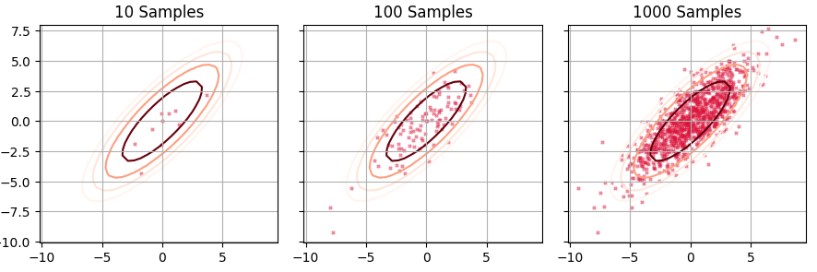
Samples build a picture of the distribution, like exposure of a polaroid
Add some Smoothing…
More samples = Clearer picture
Diminishing returns after a while

Slide 25
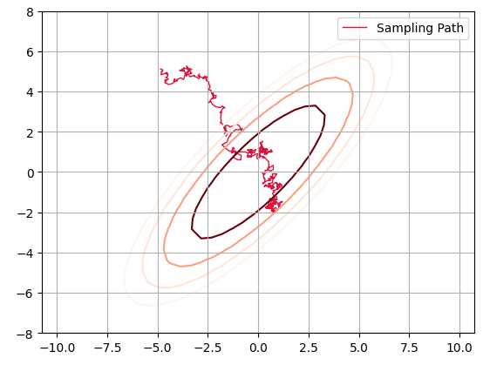

Where can things go wrong?
“Burn-in”, chain takes a bit to wander to the target dist.
Samples aren’t stationary
“Correlation”, chain takes time to wander around. Samples aren’t independent
Technically $2,000$ samples, but clearly doesn’t trace the underlying distribution

Slide 26
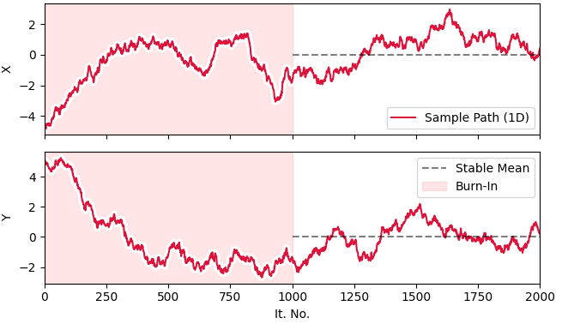
How to Check? Trace Plots
Plots of individual parameters vs iteration number.
Should look like stationary white noise: No trends, no structure

Slide 27
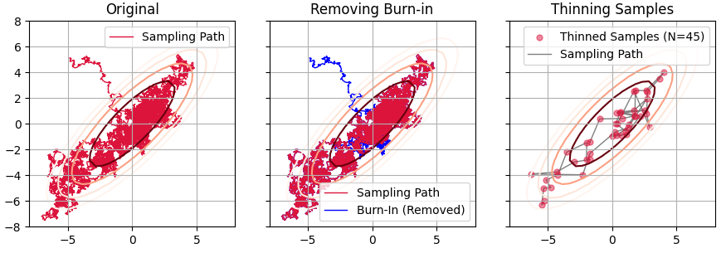
MCMC – Trimming & Thinning
Most good samplers will do thinning for you, or be built in a way that avoids correlation Burn-in is usually manual. Just set it higher until your plots don’t have any “dangly” bits

Slide 28
MCMC Methods Differ By Proposal Generation
Ensemble Based | Chain Based
Affine Invariant Ensemble Sampler (emcee) | Metropolis Hastings
Ensemble Slice Sampling (ESS) | Hamiltonian Monte Carlo (NUTS)
Sample Adaptive (SA) | Barker Metropolis Hastings (BMH)
*Uses Gradients
Rough but Robust
SA
ESS
emcee
BMH
NUTS
Fancy but Fragile
Sliding scale of simple & robust $→$ efficient & fragile

Slide 29
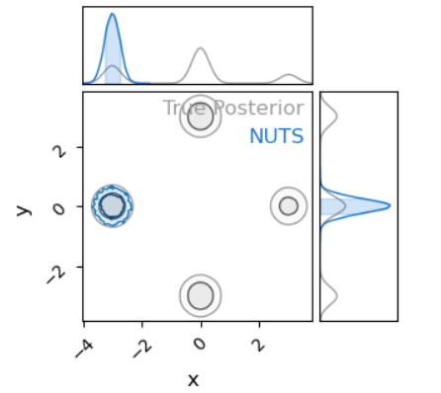
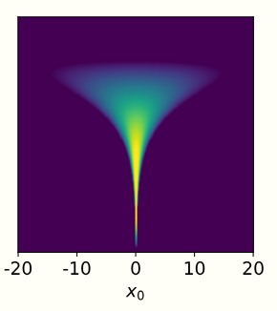
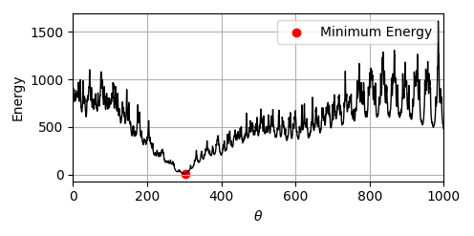
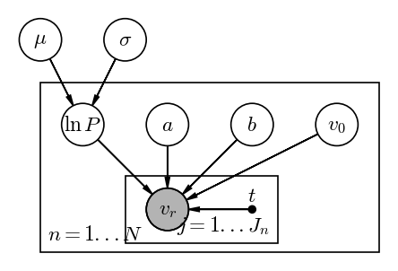
The Four Dangers of Bayesian Fitting
Multimodality
Non-Gaussianity
Rough Geometry
High Dimensionality

Slide 30
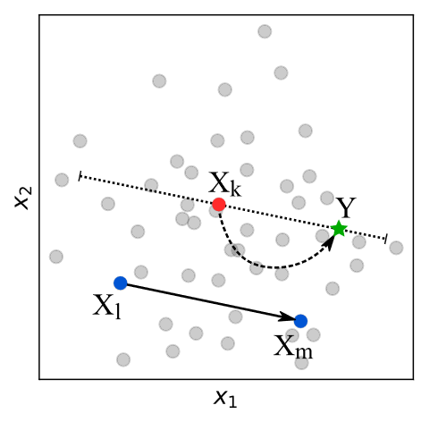
Affine Invariant Ensemble Sampler
(a.k.a. emcee)
Uses an ensemble of live points to guess the ‘shape’ and slingshot points through parameter space
Robust
Efficient
Fails at high dimension
Fails in multimodal distributions

Slide 31
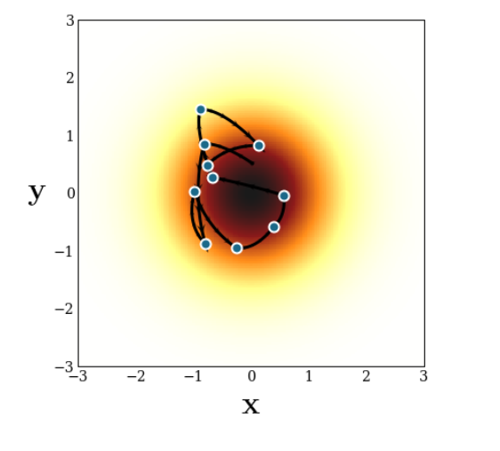
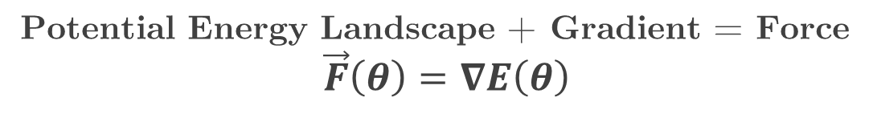
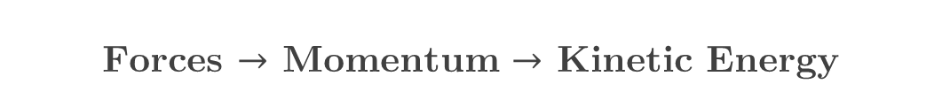
Hamiltonian Monte Carlo (HMC)
Potential Energy Landscape + Gradient = Force
$$\vec{F}\left(θ\right)=∇E\left(θ\right)$$
Forces $→$ Momentum $→$ Kinetic Energy
MCMC: Particle “Hopping” Around
HMC: Projectile “Orbiting” Around
Works for up to thousands of parameters
Breaks for rough terrain or multiple islands of probability
arXiv:1701.02434

Slide 32
But MCMC is limited…
Parameter Constraint
Model Comparison
$$Z =∫π\left(θ\right)ℒ\left(d|θ\right) dθ$$
Get the shape of the posterior
Get the normalization of the posterior

Slide 33
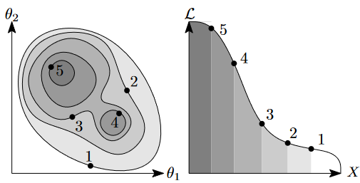
Nested Sampling
arXiv:1506.00171v1
A Sampler and Integrator
Slower than MCMC and scales worse in higher dimensions
“First and worst” method for Bayesian Fitting. Slow but versatile and hard to break

Slide 34
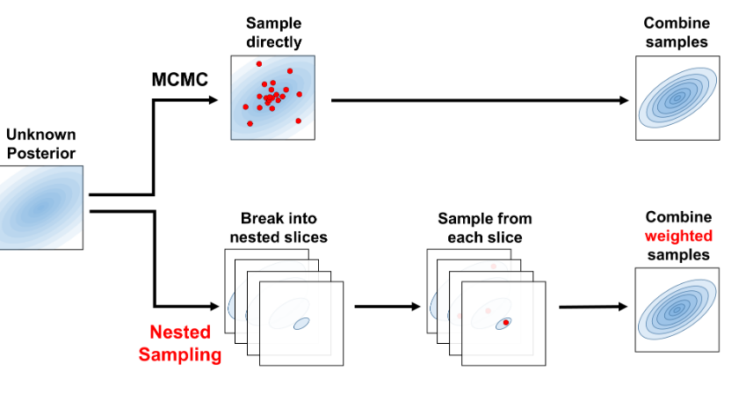
Nested Sampling vs MCMC
J Speagle, 2019 arxiv: 1904.02180

Slide 35
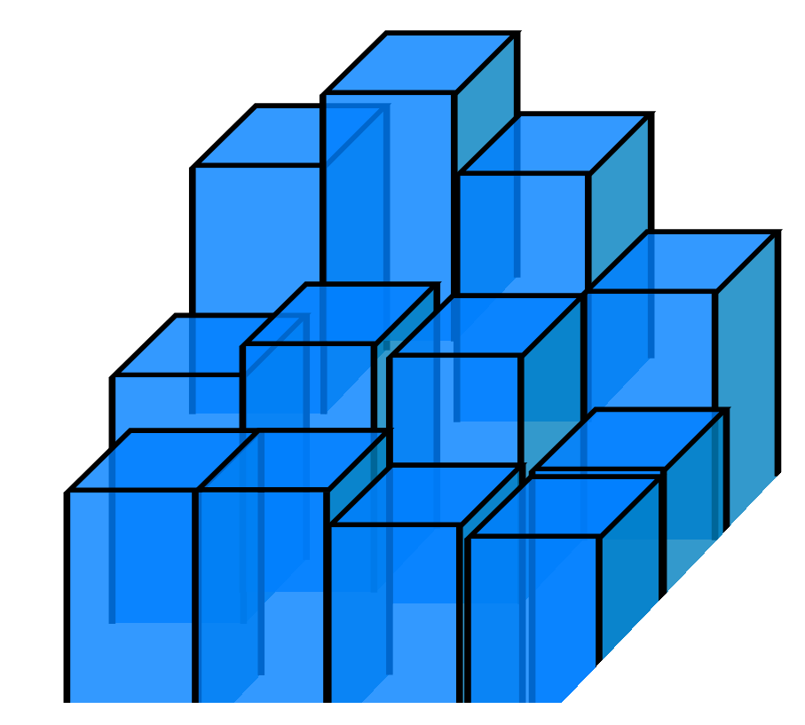
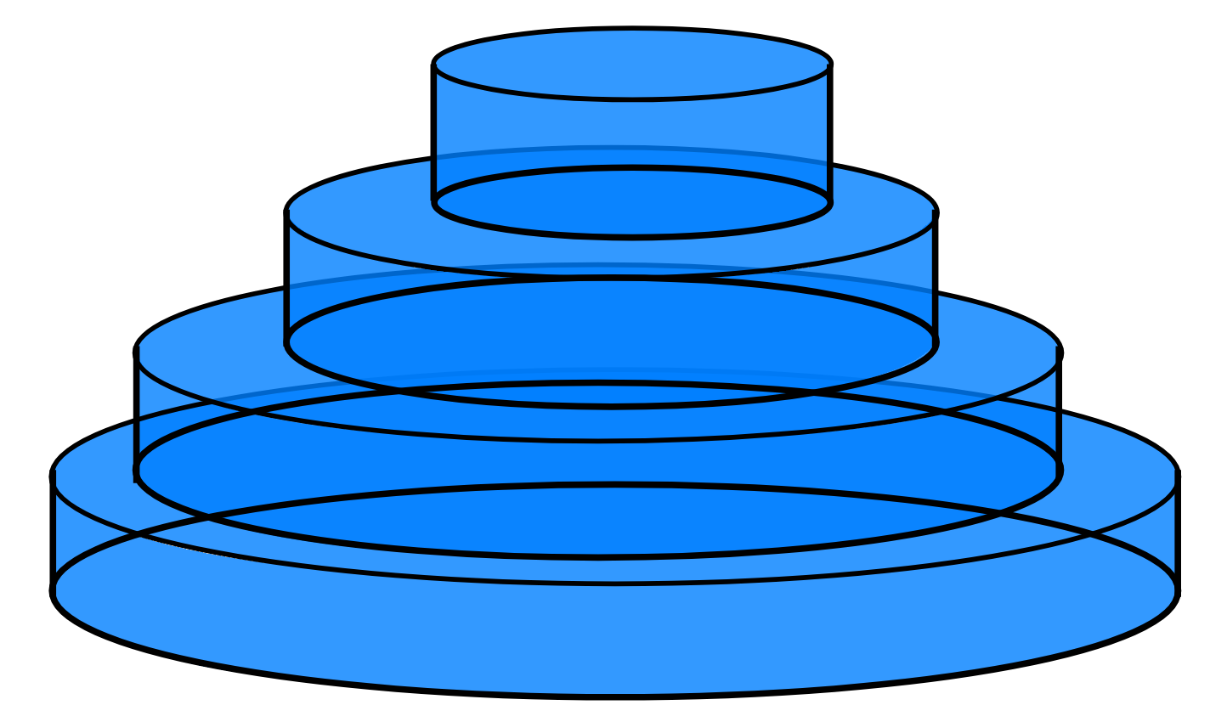
Nested Sampling – Lebesgue Integrals
Riemann Integral Chunks of known area, estimate of height
Lebesgue Integral Plates of known height, estimate of Area

Slide 36










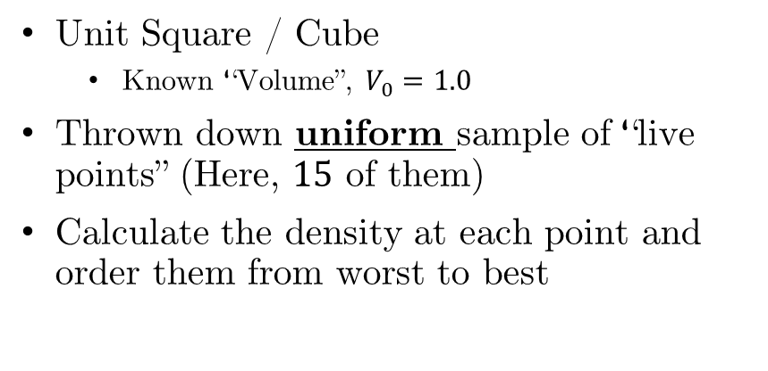





















Nested Sampling – How it Works
V = 1.0
Unit Square / Cube
Known “Volume”, $V_{0}=1.0$
Thrown down uniform sample of “live points” (Here, $15$ of them)
Calculate the density at each point and order them from worst to best
$$x_{4}$$
$$x_{16}$$
$$x_{5}$$
$$x_{3}$$
$$x_{12}$$
$$x_{10}$$
$$x_{15}$$
$$x_{6}$$
$$x_{11}$$
$$x_{13}$$
$$x_{14}$$
$$x_{8}$$
$$f(x_{14})$$
$$f(x_{15})$$
$$f(x_{13})$$
$$x_{2}$$
$$f(x_{12})$$
$$x_{9}$$
$$f(x_{11})$$
$$x_{7}$$
$$f(x_{10})$$
$$x_{1}$$
$$f(x_{8})$$
$$f(x_{9})$$
$$f(x_{7})$$
$$f(x_{6})$$
$$f(x_{5})$$
$$f(x_{4})$$
$$f(x_{3})$$
$$f(x_{2})$$
$$f(x_{1})$$

Slide 37



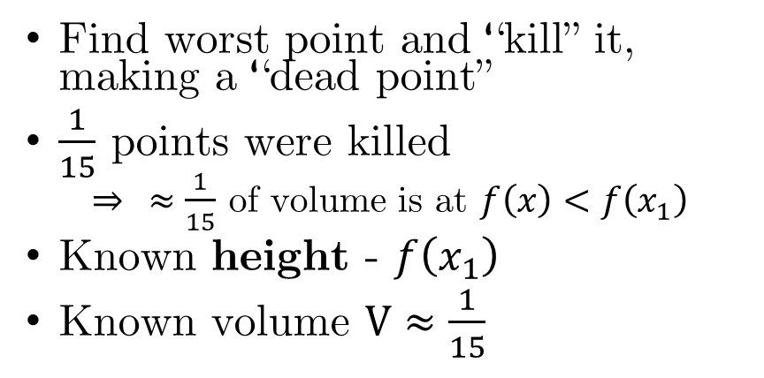




Nested Sampling – How it Works
V = 1.0
Find worst point and “kill” it, making a “dead point”
$\frac{1}{15}$ points were killed
$⇒ ≈\frac{1}{15}$ of volume is at $f\left(x\right)<f\left(x_{1}\right)$
Known height - $f\left(x_{1}\right)$
Known volume $V≈\frac{1}{15}$
$$x_{4}$$
$$x_{16}$$
$$x_{5}$$
$$x_{3}$$
$$V≈\frac{14}{15}$$
$$x_{12}$$
$$x_{10}$$
$$x_{15}$$
$$x_{6}$$
$$x_{11}$$
$$x_{13}$$
$$x_{14}$$
$$x_{8}$$
$$f(x_{14})$$
$$f(x_{15})$$
$$f(x_{13})$$
$$x_{2}$$
$$f(x_{12})$$
$$x_{9}$$
$$f(x_{11})$$
$$x_{7}$$
$$f(x_{10})$$
$$x_{1}$$
$$f\left(x\right)>f\left(x_{1}\right)$$
$$f(x_{8})$$
$$f(x_{9})$$
$$V≈\frac{1}{15}$$
$$f(x_{7})$$
$$f\left(x\right)<f\left(x_{1}\right)$$
$$f(x_{6})$$
$$f(x_{5})$$
$$V≈\frac{1}{15}$$
$$f(x_{4})$$
$$f(x_{3})$$
$$f(x_{2})$$
$$f(x_{1})$$

Slide 38









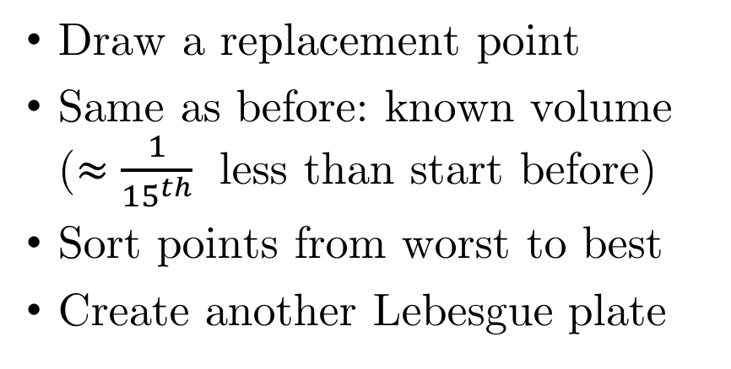












Nested Sampling – How it Works
V = 1.0$×\left(1−\frac{1}{15}\right)$
Draw a replacement point
Same as before: known volume ($≈\frac{1}{{15}^{th}}$ less than start before)
Sort points from worst to best
Create another Lebesgue plate
$$x_{3}$$
$$x_{16}$$
$$x_{4}$$
$$x_{2}$$
$$x_{11}$$
$$x_{9}$$
$$x_{15}$$
$$x_{6}$$
$$x_{12}$$
$$x_{10}$$
$$x_{13}$$
$$x_{14}$$
$$x_{8}$$
$$f(x_{14})$$
$$f(x_{15})$$
$$f(x_{12})$$
$$f(x_{13})$$
$$x_{1}$$
$$f\left(x\right)>f\left(x_{1}\right)$$
$$f(x_{11})$$
$$x_{8}$$
$$f(x_{10})$$
$$x_{7}$$
$$f(x_{9})$$
$$f\left(x\right)<f\left(x_{1}\right)$$
$$f(x_{7})$$
$$f(x_{8})$$
$$f(x_{6})$$
$$f(x_{5})$$
$$f(x_{4})$$
$$f(x_{3})$$
$$f(x_{2})$$
$$f(x_{1})$$

Slide 39


Nested Sampling – How it Works
V = 1.0$×{\left(1−\frac{1}{15}\right)}^{n}$
Repeat again and again
Build up smaller and smaller plates until we’ve covered all of the ‘mass’
$$x_{1}$$
$$f(x_{15})$$
$$f(x_{1})$$

Slide 40
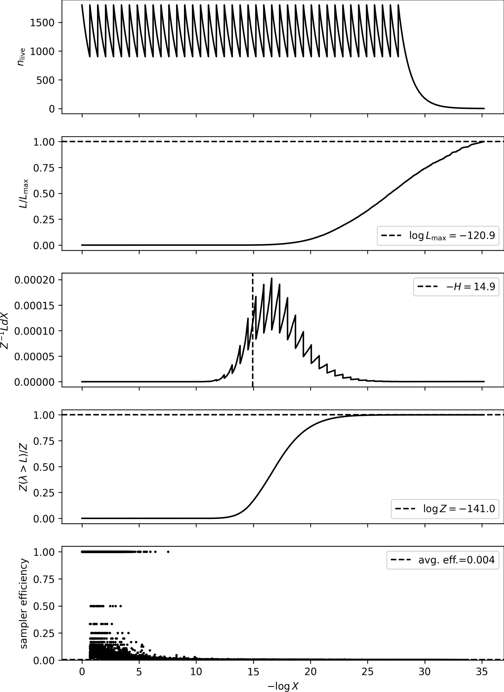
Nested Sampling: Checking Convergence
MCMC can just keep running longer to get better resolution. Nested Sampling has a fixed start and end, can’t cut off early.
Check for “mode” evaporation
Can get very slow for complex (high dimensional) problems

Slide 41





Different NS Methods: Different Live Point Proposals
dynesty
J Speagle, 2019 arxiv: 1904.02180
Polychord
W Handley, 2025 arxiv:1506.00171
JAXNS
NAUTILUS
J Albert, 2020 arxiv: 2012.15286
J Lange, 2013 arxiv: 2306.16923
J Speagle, 2019 arxiv: 1904.02180

Slide 42
Questions to Always Be Asking
Do I want to compare two models?
Yes – Probably Nested Sampling + Bayes Factor
No – Probably MCMC
Is this distribution multi-modal?
Yes – Nested Sampling, or some fancy MCMC engine
No – emcee is fine, except in high dimensions (Look into HMC)
Has my sampler actually converged?
Check trace plots / diagnostic plots
Look at corner plots + chains

Slide 43
Bonus: Other Bayesian Methods

Slide 44

Information Criteria
Compares the best possible likelihood between models with penalties for more complexity
Quick and easy ways to do rough model comparison when you can’t use evidence integrals (no prior, can’t integrate etc)

Slide 45


Importance Sampling
$$E_{T}\left[f\left(θ\right)\right]=E_{T}\left[\frac{f\left(θ\right)}{P_{S}\left(θ\right)}P_{S}\left(θ\right)\right]=E_{S}\left[\frac{f\left(θ\right)}{P_{S}\left(θ\right)}\right]$$
Re-weight samples from an existing fit (e.g. MCMC, grid, NS) to trace a new distribution.

Slide 46

Stochastic Variational Inference (SVI)
Assume some shape for the posterior (e.g. normal dist.) and mould it to fit the true posterior as best you can
Can be used to estimate evidence integrals | works in high dimensions

Slide 47







Simulated Bayesian Inference (SBI)
$$π\left(θ\right)$$
$$ℒ\left(d | θ\right)$$
Parameters go in
Sometimes don’t have a simple functional form for this (e.g. galaxy formation sims)
$$θ$$
$$d$$
Forward model is easy (simulations)
Use Machine Learning to learn joint density, use as a surrogate likelihood

Slide 48
Thank you!
Questions?

